Slide 1


Slide 2

BUSINESS ETIQUETTE - 3

Slide 3

Open And Objective Communication: The Cornerstone of Business Success
Open and objective communication is essential for building strong business relationships and achieving success.
Open communication is when people can openly express their thoughts and ideas to one another in a business/organization.
This presentation will explore key principles and strategies for effective communication in the professional world.

Slide 4
Understanding Open and Objective Communication
Key elements of open communication:
Honesty and transparency
Active listening
Clear and concise expression
Respectful dialogue
Feedback and constructive criticism
Key elements of objective communication:
Focus on facts and data
Avoiding emotional bias
Considering multiple perspectives
Maintaining neutrality
Using clear and neutral language

Slide 5

The Importance of Open and Objective Communication
Open and objective communication is crucial for building strong relationships, fostering teamwork, and achieving business goals.
It will help in resolving conflicts effectively and enhances our decision-making in crucial situations which in turn boosts employee morale and engagement in the workplace.
It creates a positive work environment and leads to better decision-making.

Slide 6
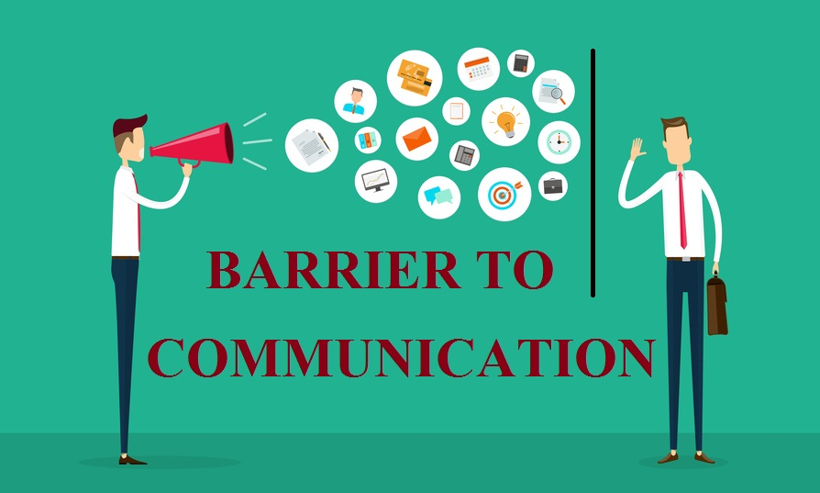
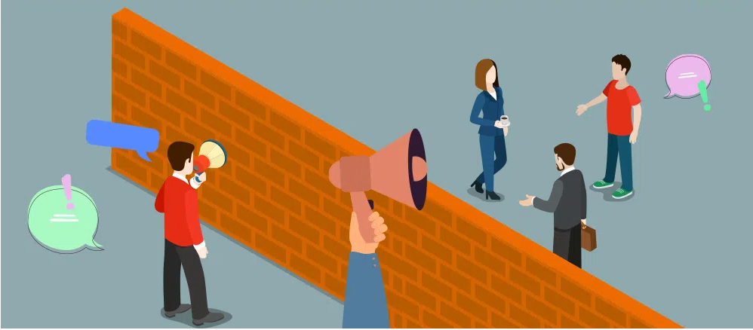
COMMON COMMUNICATION BARRIERS

Slide 7
Physical Barriers- Physical barriers are environmental factors that hinder communication. Noise, distance, and technological issues can disrupt the message transmission.
Physiological Barriers-physical state of the communicator.,Hearing impairments, speech difficulties, can impede effective communication.
Psychological Barriers-Psychological barriers stem from mental attitudes or perceptions. Fear, anxiety, and mistrust can create obstacles in understanding and sharing information.
Semantic Barriers-Semantic barriers arise from language-related issues. Different interpretations of words, jargon, and technical terms can lead to misunderstandings.
Cultural Barriers-Cultural barriers occur due to differences in values, beliefs, and customs.
Organizational Barriers-Organizational barriers are related to the structure and hierarchy of an organization.

Slide 8

Strategies for overcoming barriers
Implement active listening techniques to fully comprehend the speaker's message, demonstrating empathy and respect, which encourages open dialogue.
Effective communication requires clarity and conciseness. Structure your message logically, using simple and direct language. This enhances understanding and prevents misunderstandings.
Building Trust is the foundation of open communication. Be honest, transparent, and reliable. Keep your promises and be consistent in your actions. Demonstrate empathy and understanding.

Slide 9

Strategies for overcoming barriers
Adapt to different cultural norms and communication styles and respect diverse viewpoints and values which fosters inclusive and collaborative interactions.
Foster a culture of psychological safety where individuals feel comfortable sharing diverse perspectives and ideas without fear of judgment or reprisal.
Be open to constructive criticism and use it as an opportunity to learn and grow. By creating a culture of open feedback, you foster a more effective and collaborative environment.

Slide 10

Two-Way Dialogue in Business Etiquette

Slide 11

What is two way Dialogue?
Two-way dialogue is a fundamental aspect of business etiquette. It is a dynamic exchange of information and ideas between two or more parties.
Unlike one-way communication where information flows in a single direction, two-way communication involves active participation from both the sender and receiver. It involves active listening, clear expression, and mutual respect.

Slide 12

The Importance of Active Listening
Builds trust and rapport: By demonstrating that you are genuinely interested in what the other person is saying, you cre ate a foundation of trust and respect.
Enhances understanding: Active listening helps ensure that you accurately comprehend the speaker's message, preventing misunderstandings and conflicts.
Fosters collaboration: By fully understanding different perspectives, you can work together more effectively to find common ground and solutions.
Improves problem-solving: Actively listening to all sides of an issue can help identify root causes and develop creative solutions.
Demonstrates respect: Showing that you value the other person's input by paying close attention makes them feel heard and appreciated.

Slide 13

Role of Non Verbal Communication in 2 way Dialogue
Key points:
Non-verbal cues complement verbal communication.
Maintain appropriate body language, eye contact, and facial expressions.
Be aware of cultural differences in non-verbal communication.
Use gestures effectively to emphasize points.
Ensure consistency between verbal and non-verbal messages.

Slide 14
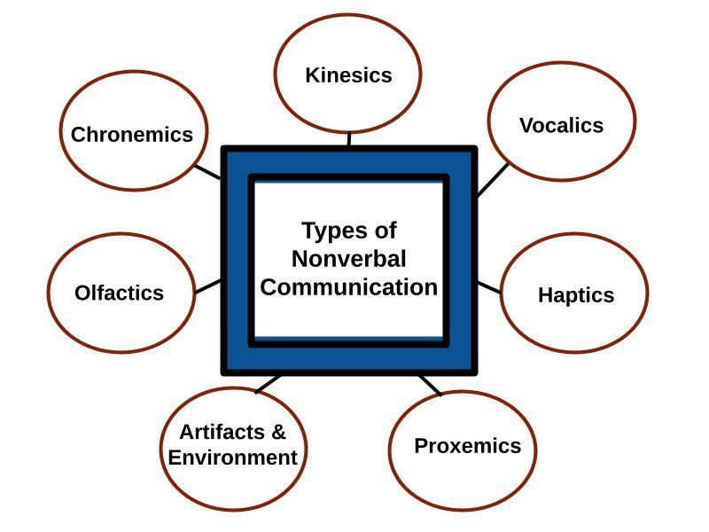
Types of Non-verbal Communication

Slide 15
Types of Non-verbal Communication
Kinesics -refers to the study of hand, arm, body, and face movements. There are specifically at three different types of kinesics: facial expressions, eye behavior (oculesics) and gestures.
Vocalics -focuses not on the words that we choose, but the manner in which we say the words using our vocal cords. It includes the study of paralanguage, which we use to produce sounds orally.
Haptics is the study of communication by touch. Touch may indicate liking, attraction, or dominance.. It is a very powerful form of communication that can be used to communicate messages ranging from comfort to power.

Slide 16
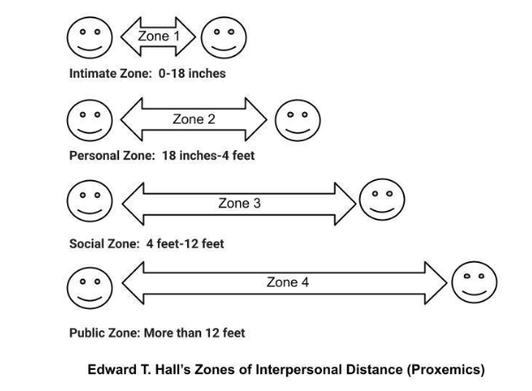
Types of Non-verbal Communication
Proxemics, is the study of communication through space, was strongly influenced by the anthropologist Edward T. Hall back in the 1968. He categorized space into four “distances” They are Intimate space(<18 inches), Personal space(18 inches to 4 feet),Social distance(4-12 feet), Public distance(>12 feet).

Slide 17
Types of Non-verbal Communication
Artifacts and Environment-Artifacts are items with which we adorn our bodies or that we carry with us like glasses, jewelry, canes, shoes, clothing, or any object associated with our body that communicates meaning. That includes tattoos and piercings.
Olfactics-The sense of smell communicates messages. The term olfactics refers to the influence of scent on perceptions.
Chronemics refers to the study of how time affects communication. Time can be classified into several different categories, including biological, personal, and cultural time

Slide 18

Identifying your Audience-Target Audience
Effective communication starts with identifying your audience.
Tailoring your message enhances understanding and engagement.
Examples: Employees, clients, partners, stakeholders.
Research demographics, roles, and interests of target audience .
Adapt your communication style to resonate with the audience.
Use surveys, data analytics, and feedback for insights to resonate with your audience.

Slide 19
Understanding Your Audience: The Foundation of Effective Communication
1) Define the Purpose of Your Communication-Clearly outline the objective of your communication. Are you informing, persuading, or building relationships?.
2) Conduct Audience Analysis
Demographics: Consider factors like age, gender, occupation, education level, income, and cultural background.
Psychographics: Explore their interests, values, attitudes, lifestyles, and personality traits.
Behaviors: Analyze their buying habits, media consumption, and online behavior.
Needs and Wants: Determine what your audience is looking for and what problems they are trying to solve.

Slide 20
Understanding Your Audience
3) Create Audience Personas
Develop fictional representations of your ideal customer or client.
Give them names, demographics, goals, challenges, and behaviors.
This will help you visualize your target audience and tailor your communication accordingly.
4) Consider the Communication Channel
The chosen channel will influence the target audience.
For example, a formal email might be suitable for a professional audience, while a social media post might reach a younger demographic.
5) Gather Feedback and Refine
Continuously gather feedback from your audience to refine your understanding.
Use surveys, questionnaires, or analytics to measure the effectiveness of your communication.

Slide 21
QUESTION 1
Which of the following is NOT a benefit of open and objective communication within a company?
Encouragement of personal opinions over factual information
Increased employee morale and engagement
Reduced risk of misunderstandings and conflicts
Improved decision-making through diverse perspectives
Notes:
ANS:C

Slide 22
QUESTION 2
When delivering critical feedback to a colleague, it's important to:
Publicly criticize their work in front of others.
Focus on personal attacks rather than the specific issue.
Schedule a private conversation and offer constructive solutions.
Send an anonymous email highlighting their shortcomings.
Notes:
ANS:C

Slide 23
QUESTION 3
Active listening in internal communication involves:
Talking over others and interrupting their points.
Paying close attention to the speaker's message and body language.
Focusing on formulating your own response while the other person speaks.
Making assumptions about what the speaker will say next.
Notes:
ANS:B

Slide 24
QUESTION 4
Which of the following is an appropriate way to address a company-wide announcement?
Sharing the information through personal gossip channels.
Using an official communication platform like email or internal portal.
Spreading rumors and speculation about the announcement.
Only informing individuals you believe need to know.
Notes:
ANS:B

Slide 25
QUESTION 5
Open communication within a company fosters a culture of:
Secrecy and withholding information from colleagues.
Transparency, trust, and collaboration.
Micromanagement and strict hierarchical structures.
Discouraging open dialogue and feedback.
Notes:
ANS:B

Slide 26
QUESTION 6
Non-verbal cues like eye contact and body language can indicate:
Disinterest and a lack of attentiveness in the conversation.
Active listening, engagement, and potential understanding.
Solely relying on the spoken words without considering non-verbal cues.
Ignoring non-verbal signals entirely during communication.
Notes:
ANS:B

Slide 27
QUESTION 7
Effective communication delivery involves:
Speaking in a monotone and lacking any enthusiasm.
Varying your tone, pace, and volume to keep the audience engaged.
Using excessive filler words and phrases that hinder clarity.
Speaking too rapidly without allowing the audience to absorb the information.
Notes:
ANS:B

Slide 28
QUESTION 8
Clarifying questions demonstrate:
A lack of attentiveness and a misunderstanding of the conversation.
Active listening and a desire to ensure clear understanding.
Disrespect for the speaker and their expertise.
A need to interrupt the conversation and take control.
Notes:
ANS:B

Slide 29
QUESTION 9
Body language plays a significant role in business communication. Slouching and looking away could potentially indicate:
Confidence and expertise.
Disinterest, boredom, or lack of attentiveness.
Active listening and engagement in the conversation.
A sign of agreement with the speaker.
Notes:
ANS:B

Slide 30
QUESTION 10
When presenting complex information, it's recommended to:
Rush through the details without allowing time for questions.
Break down the information into manageable chunks and use clear, concise language.
Focus on technical jargon and industry-specific terms.
Avoid visuals and rely solely on verbal communication.
Notes:
ANS:B

Slide 31
THANK YOU

